Slide 1

WELCOME

Slide 2

Structured Debriefing

Slide 3
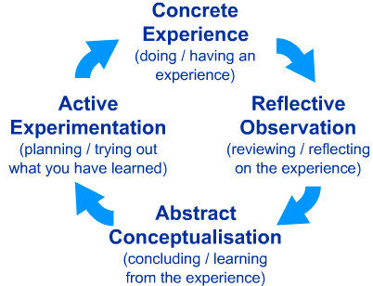
Lewin’s/Kolb’s Learning Cycle
http://www.ldu.leeds.ac.uk/ldu/sddu_multimedia/kolb/static_version.php

Slide 4
Structured Debriefing
Promoting Performance
Technical aspects and Human factors
Mutually engaging and learning
Guided reflection
Time efficient tool
Evidence based Tool.

Slide 5
SHARP
S Set learning objectives
H How did it go
A Address concerns
R Review learning points
P Plan ahead

Slide 6
Set Learning Objectives
What would you like to get out of this case:
Cognitive (e.g. proficiency in chronic disease diagnosis and management)
Affective (e.g. maintaining composure while dealing with difficult patient)
Psychomotor (e.g. use of CAGE in alcohol use, HEADDSS in adolescents, Hand washing before examination)

Slide 7
Set Learning Objectives
Communication skills and rapport ( active listening, empathy, verbal vs non verbal reflection etc.)
Setting scene for the consultation
History taking: focused, templates
System check, physical examination, patient's considerations
Diagnosis and differentials
Investigations, reasoning and cost
Management, Bio-psycho-social approach
Time management

Slide 8
How did it go
What went well
Why
Doctor’s Factors
Patient's factors
environment

Slide 9
Address concerns
What did not go well
Why
Doctor’s Factors
Patient's factors
environment

Slide 10
Review Learning Points
Were your learning objectives met
What did you learn about your clinical/technical skills
What did you learn about your teamwork skills

Slide 11
Plan ahead
What actions can you take to improve your future practice?

